Slide 1
Detecting Waste in Recycling Facilities Using Object Detection
GROUP MEMBERS:
Abdu Sallouh, Jumana Bakr, Saja Hader, Yassmin Helmy

Slide 2
Introduction
Handling unsorted litter is recycling facilities:
time consuming
Requires a lot of labour
Proposed solution:
Using automation to detect types of waste
Challenges:
“in the wild” waste is difficult to sort
Low accuracy when properly categorizing waste items instantaneously.

Slide 3
Problem Statement
Consideration of “in the wild” sorting of waste requires systems to diligently identify multiple waste items at the same time, categorize them properly, and assure this can happen on the clock with high accuracy. Current waste classification systems still need improvement to ensure accurate and efficient sorting under varied environmental conditions.
The project would tackle concepts in computer vision related to the usage of deep neural networks in identifying objects in cluttered environments, taking in mind foreground-background imbalances as well as the Intersection over Union (IoU) scores of such models.

Slide 4
Literature Review
Useful papers:
ZeroWaste Dataset: Towards Deformable Object Segmentation in Cluttered Scenes [1].
Object Detection Based Management System of Solid Waste Using Artificial Intelligence Techniques [2].
Garbage detection and classification using a new deep learning-based machine vision system as a tool for sustainable waste recycling [3]

Slide 5
Literature Review
ZeroWaste Dataset: Towards Deformable Object Segmentation in Cluttered Scenes [1]
ZeroWaste-f dataset for supervised detection and evaluation. It is fully annotated and composed of 4661 frames
Used RetinaNet, MaskRCNN, TridentNet
Best mean average precision (APm) of 10.7 using TridentNet
Object Detection Based Management System of Solid Waste Using Artificial Intelligence Techniques [2]
The dataset of 130,000 images and includes locally sourced data, and is annotated with 12 waste classes.
Used ResNet50, SSD ResNet101, YOLOv5, and a customized RCNN variant
The customized RCNN (MD) emerged as the top performer with 73% accuracy rate and an F1 score of 0.729.
Garbage detection and classification using a new deep learning-based machine vision system as a tool for sustainable waste recycling [3]
HUAWEI-40 dataset with 14,683 images of four categories and a total of 40 classes
Model consists of four parts: MobileNetV2 backbone, a CBAM, PCA, and a fully connected classification layer.
The improved MobileNetV2 gave 90.7% accuracy, while the original network gave 81.7%

Slide 6
Methodology
Object detection and classification
Used ZeroWaste-f dataset created by Bashkirova et al. [1]
It is a labeled dataset
Has 4 classes: soft plastic, rigid plastic, cardboard, metal
Ran 6 Models:
RetinaNet
TridentNet
Mask R-CNN
RT-DETR
YOLOv6
YOLOv8

Slide 7
Implementation: RetinaNet
Utilized Detectron2
Detectron2 is an open-source computer vision library developed by Facebook AI Research (FAIR). It's a framework built on top of PyTorch that provides a collection of state-of-the-art object detection algorithms and models.
Finetuned a COCO-Pretrained R50-FPN model on our dataset
Backbone architecture: Feature Pyramid Network (FPN) with ResNet backbone. We have 8FPN layers and 28 ResNet layers
images per batch: 8
learning rate: 0.002
max iterations: 1500
Model Evaluation
We set a threshold of 0.8 for test time inference. Objects with detection scores above this threshold will be considered as positive detections
We used performed inference using the trained model on the test dataset and used a COCO evaluator to evaluate the model

Slide 8
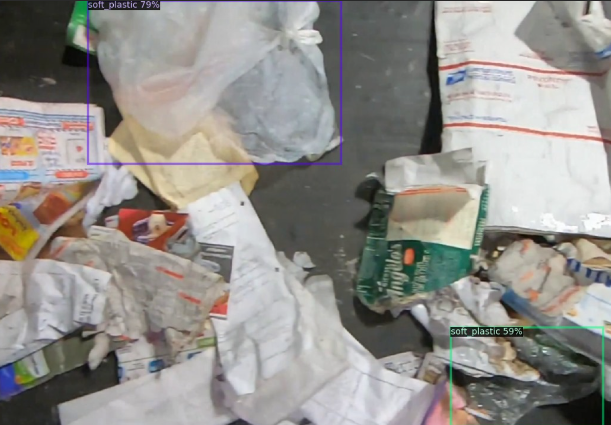
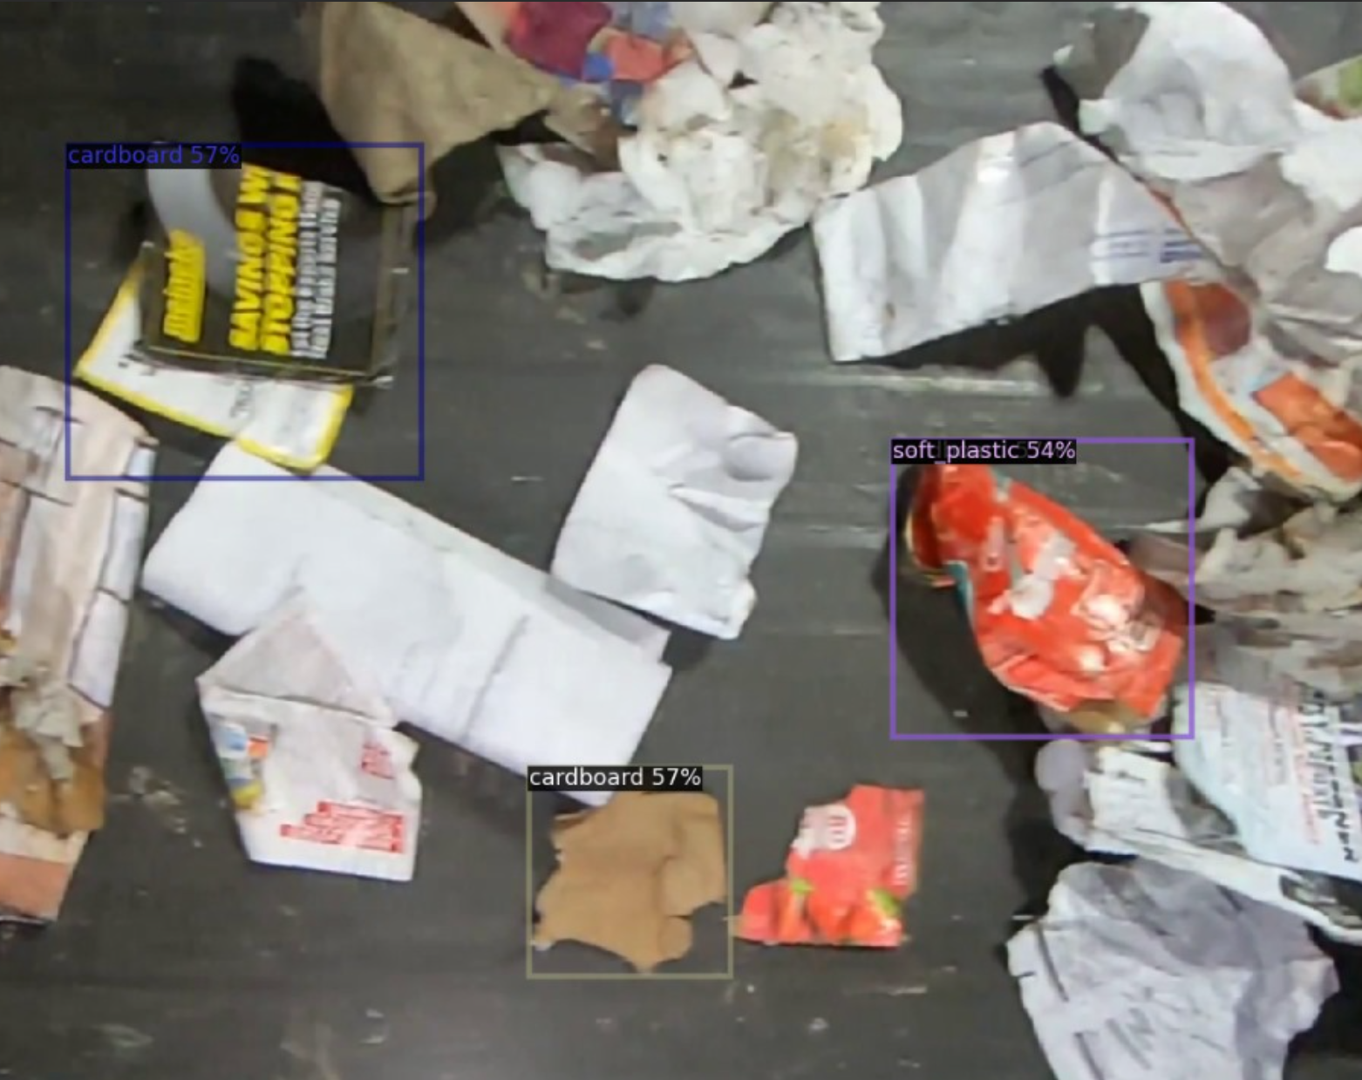
Results: RetinaNet
soft plastic 79%
cardboard 57%
Figure 1: Results obtained using RetinaNET
Figure 2: Results obtained using RetinaNET

Slide 9
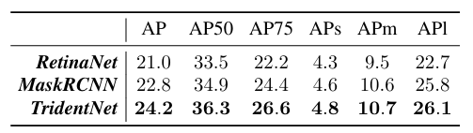
Performance evaluation: RetinaNet
Overall Model Performance (%)
AP | AP50 | AP75 | APs | Apm | Apl
20.301 | 31.542 | 21.112 | 9.851 | 15.988 | 21.238
Figure 3: Evaluation on RetinaNet obtained in [1]
Category | Rigid Plastic | Soft Plastic | Cardboard | Metal
AP (%) | 13.545 | 27.385 | 36.307 | 3.966

Slide 10
Implementation: Mask R-CNN
Utilized Detectron2
Detectron2 is an open-source computer vision library developed by Facebook AI Research (FAIR). It's a framework built on top of PyTorch that provides a collection of state-of-the-art object detection algorithms and models.
Finetined a COCO-Pretrained R50-FPN Mask R-CNN model on our dataset
images per batch: 4
learning rate: 0.005
max iterations: 4000
Model Evaluation
We set a threshold of 0.8 for test time inference. Objects with detection scores above this threshold will be considered as positive detections
We used performed inference using the trained model on the test dataset and used a COCO evaluator to evaluate the model

Slide 11
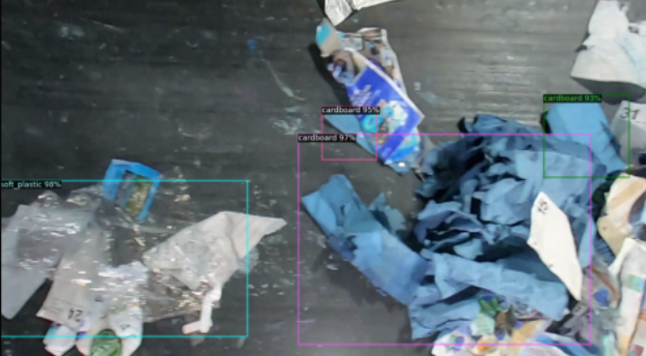
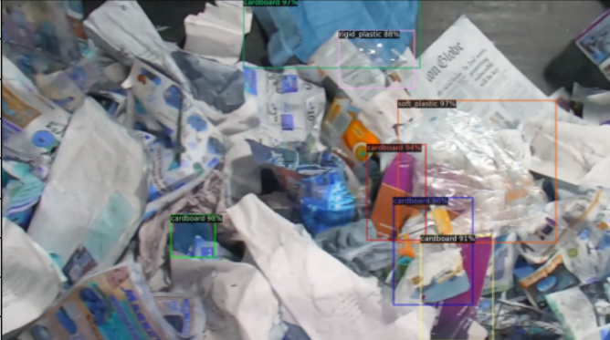
Results: Mask R-CNN
soft plastic 98%
cardboard 97%
cardboard 95%
Figure 4: Results obtained using Mask R-CNN
Figure 5: Results obtained using Mask R-CNN

Slide 12
Performance Evaluation: Mask R-CNN
Overall Model Performance (%)
AP | AP50 | AP75 | Aps | Apm | Apl
27.668 | 42.649 | 30.176 | 8.681 | 15.209 | 29.619
Figure 6: Evaluation on Mask RCNN obtained in [1]
Category | Rigid Plastic | Soft Plastic | Cardboard | Metal
AP (%) | 20.677 | 30.51 | 37.512 | 21.974

Slide 13
Implementation: TridentNet
Utilized Detectron2
Detectron2 is an open-source computer vision library developed by Facebook AI Research (FAIR). It's a framework built on top of PyTorch that provides a collection of state-of-the-art object detection algorithms and models.
Finetuned a COCO-Pretrained R50-FPN Mask R-CNN model on our dataset
images per batch: 8
learning rate: 0.0005
max iterations: 100
Model Evaluation
We set a threshold of 0.85 for test time inference. Objects with detection scores above this threshold will be considered as positive detections
We used performed inference using the trained model on the test dataset and used a COCO evaluator to evaluate the model

Slide 14
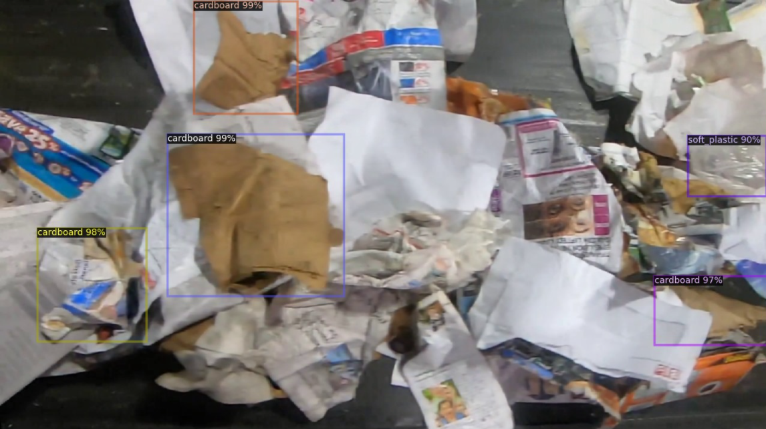
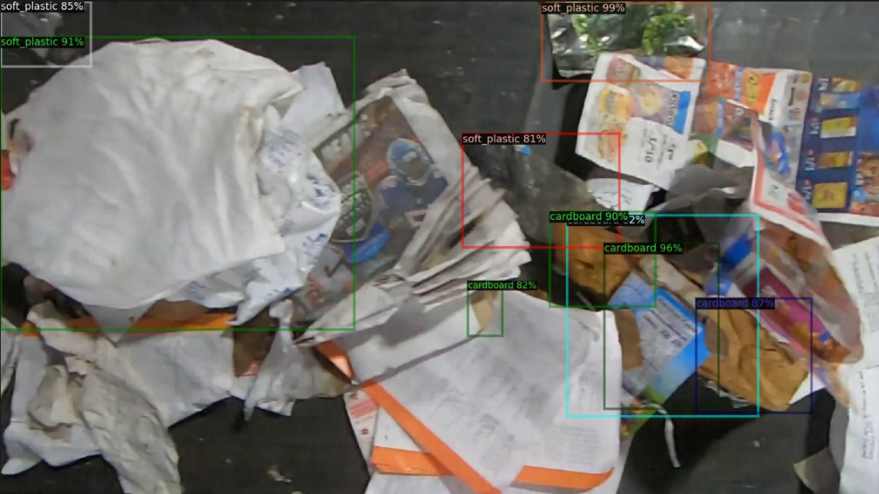
Results: TridentNet
cardboard 99%
soft plastic 90%
Figure 7: Results obtained using TridentNet
Figure 8: Results obtained using TridentNet

Slide 15
Performance Evaluation: TridentNet
Overall Model Performance (%)
AP | AP50 | AP75 | APs | Apm | Apl
31.643 | 46.750 | 35.626 | 4.746 | 16.256 | 34.863
Figure 9: Evaluation on TridentNet obtained in [1]
Category | Rigid Plastic | Soft Plastic | Cardboard | Metal
AP (%) | 31.006 | 33.379 | 37.265 | 24.923

Slide 16
Implementation: RT-DETR
Utilized Ultralytics Library
Ultralytics is an open-source computer vision library developed for object detection and related tasks. It provides implementations of various object detection algorithms and models, including YOLO and RT-DETR.
Build Model
Number of layers: 673
Number of parameters: 32814296
Number of gradients: 32814296
Computational workload: 108.0 GFLOPs
Loaded and trained on the pretrained COCO8 RT-DETR-l model
images per batch: 16
learning rate: 0.01
max iterations: 30
optimizer: AdamW

Slide 17
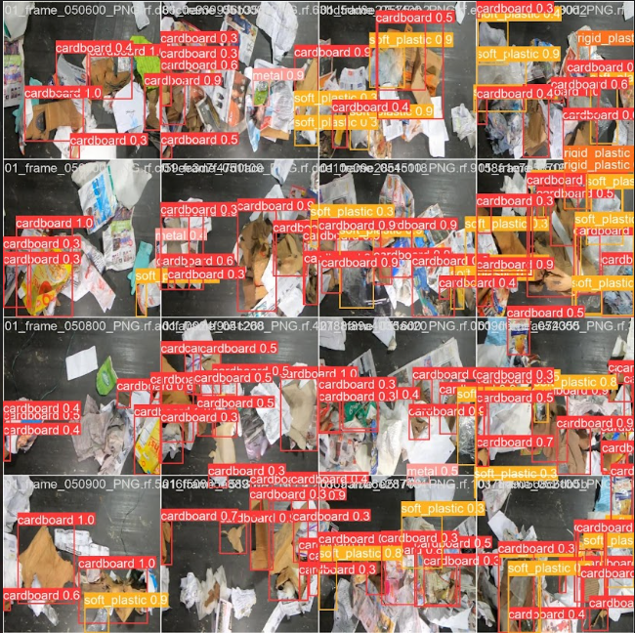
Results: RT-DETR
This model is good at detecting cardboard (red) and soft plastic (yellow)
Figure 10: Results obtained using RT-DETR

Slide 18
Performance Evaluation: RT-DETR
Overall Model Performance (%)
Precision | Recall | F1-score | AP50 | AP50-95
58.065 | 39.421 | 46.960 | 37.245 | 25.815

Slide 19
Implementation: YOLOv6
Build a YOLOv6 model
Number of layers: 195
Number of parameters: 4238540
Number of gradients: 4238524
Computational workload: 11.9 GFLOPs
Train the YOLOv6 model
Optimizer: AdamW
Learning rate: 0.00125 and momentum of 0.9
Trained for 30 epochs

Slide 20
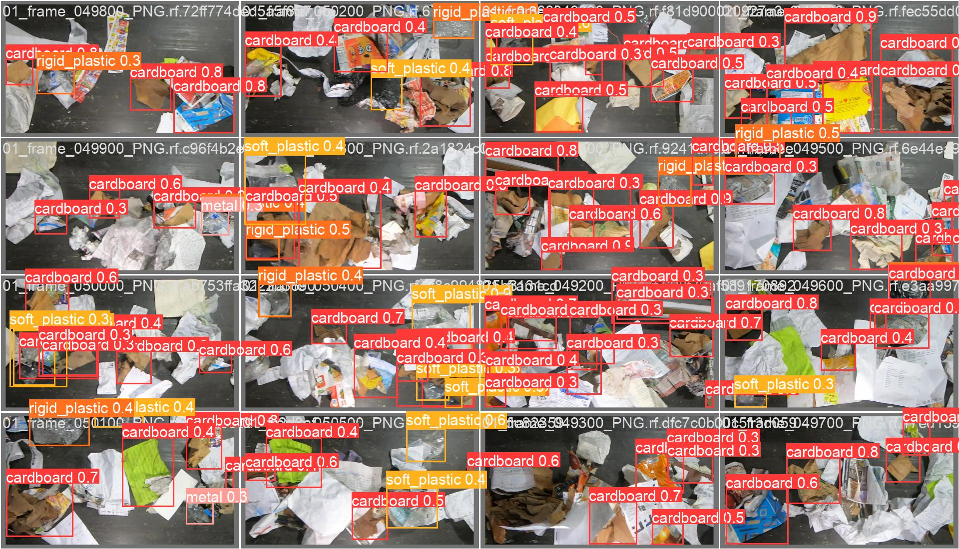
Results: YOLOv6
Figure 11: Results obtained using YOLOv6

Slide 21
Performance evaluation: YOLOv6
Overall Model Performance (%)
Precision | Recall | F1-score | AP50 | AP50-95
32.00 | 33.20 | 32.59 | 26.00 | 16.40

Slide 22
Implementation: YOLOv8
Build a YOLOv8 model
Number of layers: 225
Number of parameters: 11137148
Number of gradients: 11137132
Computational workload: 28.7 GFLOPs
Train the YOLOv8 model
Optimizer: AdamW
Learning rate: 0.00125 and momentum of 0.9
Trained for 30 epochs

Slide 23
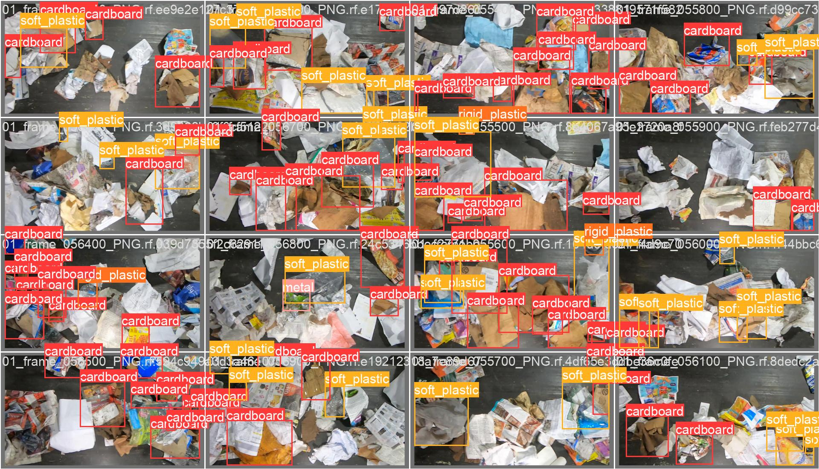
Results: YOLOv8
Figure 12: Results obtained using YOLOv8

Slide 24
Performance evaluation: YOLOv8
Overall Model Performance (%)
Precision | Recall | F1-score | AP50 | AP50-95
40.90 | 40.90 | 40.90 | 37.00 | 26.10

Slide 25
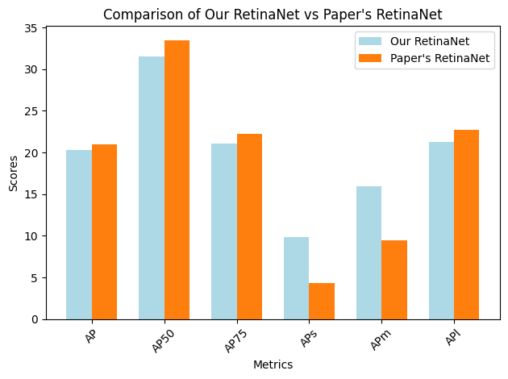
Discussion: RetinaNet

Slide 26
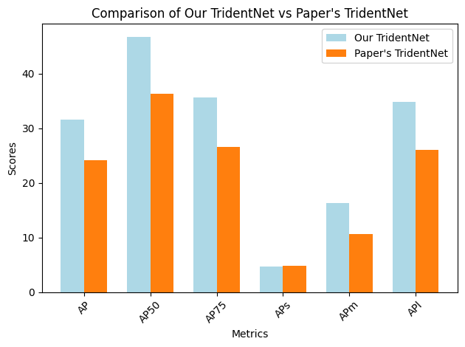
Discussion: TridentNet

Slide 27
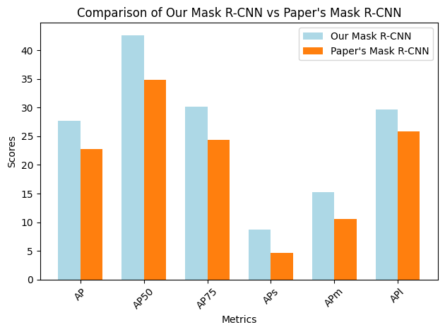
Discussion: Mask RCNN

Slide 28
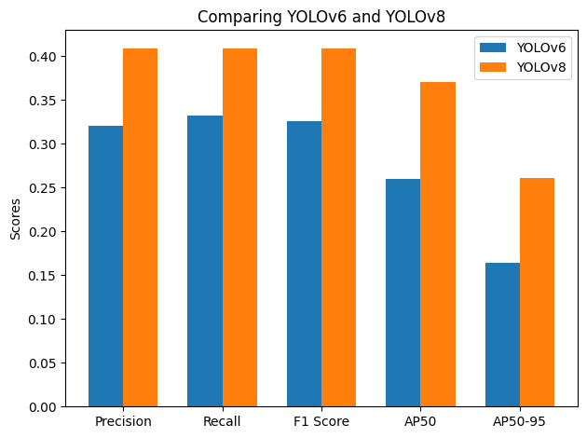
Discussion: YOLOv6 vs YOLOv8

Slide 29
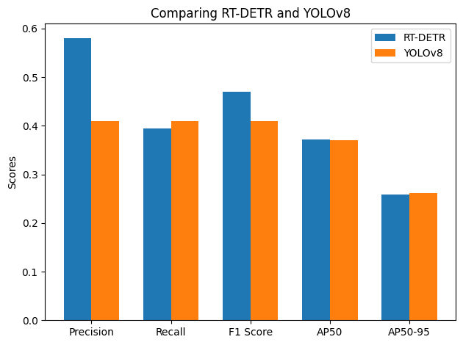
Discussion: RT-DETR vs YOLOv8

Slide 30
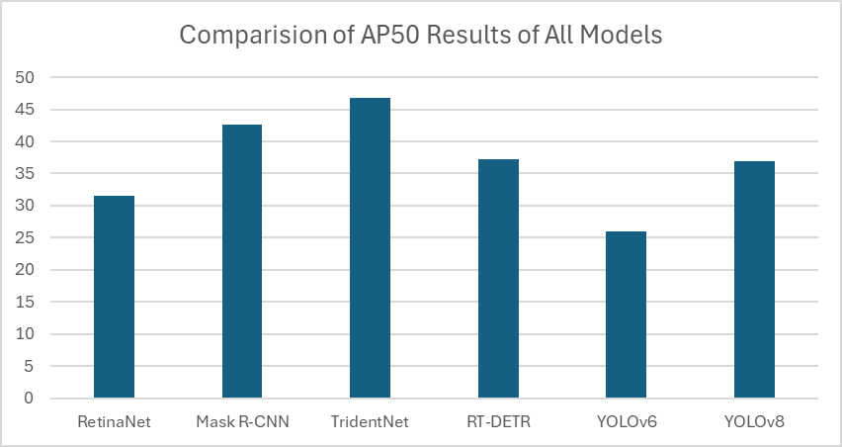
Discussion

Slide 31
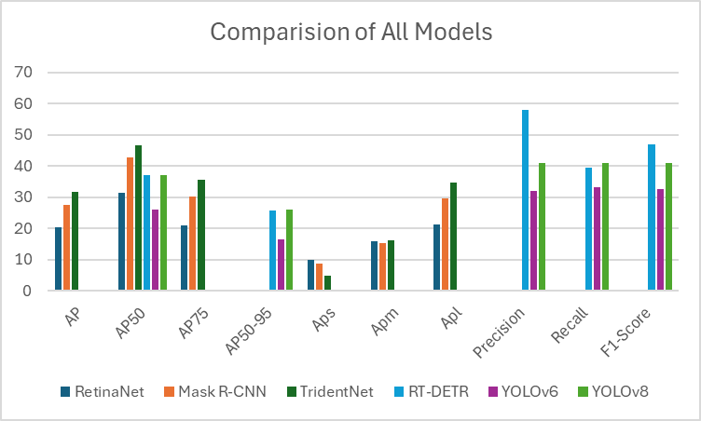
Discussion

Slide 32
Work Division
Abdu | Jumana
Proposal RetinaNet, TridentNet, RT-DETR Video | Proposal Mask R-CNN, YOLOv6 README Files, presentation
Saja | Yassmin
Proposal Mask R-CNN, YOLOv6 Presentation (Problem Statement, Literature Review, Implementation,Results, Discussion) | Proposal YOLOv8 Presentation (implementation,Results, Discussion)
Notes:
Proposal
YOLOv8
Presentation (implementation,Results, Discussion)

Slide 33

Demonstration

Slide 34
References
[1] D. Bashkirova et al., “ZeroWaste dataset: Towards deformable object segmentation in cluttered scenes,” IEEE/CVF Conference on Computer Vision and Pattern Recognition (CVPR), pp. 21147–21157, Jun 2022, doi: 10.1109/cvpr52688.2022.02047.
[2] T. Chowdhury et al., “Object Detection Based Management System of Solid Waste Using Artificial Intelligence Techniques,” 2022 IEEE 13th Annual Ubiquitous Computing, Electronics & Mobile Communication Conference (UEMCON), Oct. 2022, doi: 10.1109/UEMCON54665.2022.9965643
[3] S. Jin, Z. Yang, G. M. Królczyk, X. Liu, P. Gardoni, and Z. Li, “Garbage detection and classification using a new deep learning-based machine vision system as a tool for sustainable waste recycling,” Waste Management, vol. 162, pp. 123–130, May 2023, doi: 10.1016/j.wasman.2023.02.014.

